Slide 1
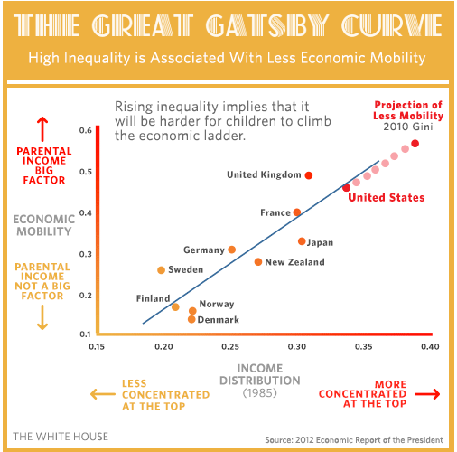
3..
2.
7.
1.
6.
5.
4.
Where would you place: the US, the UK, Germany, France, Norway, Japan and New Zealand?

Slide 3
We’ve reached the end of The Great Gatsby and what a journey. If you’re anything like me, you’ve loved and despised almost every character in the book at some point during the reading and discussion. Perhaps this paradox is Fitzgerald’s point. Perhaps the early 1920’s were just that - a paradox: a statement that, despite sound (or apparently sound) reasoning from acceptable premises, leads to a conclusion that seems senseless, logically unacceptable, or self-contradictory. It seems to be a time when things were fun and carefree; I envy the lifestyles represented in the book. Yet, at the same time, I wouldn’t want to be in the position of ANY of Fitzgerald’s characters! He masterfully made me feel both ways, at the same time!
Some of the Novel’s Themes:
Money, materialism and our quest for wealth breeds corruption and selfishness.
Modern love (modern for this time period) is displayed through violence and egoism rather than affection and tenderness.
Time cannot be recaptured; things change.

Slide 4
Answer the Final Reflective Question
Use specific from the novel and out discussions in your answer.
Be thorough and complete.
When you are done, turn the worksheet in with your novel.
Enjoy the excerpts-
As you watch, look for the ideals of the early 1920s that we discussed in our intro work, and the ideas of theme that you just talked about.
If you have seen these clips before, try to watch with fresh eyes. Do things seem different now that you’ve investigated the paradox of the time.

