Slide 1
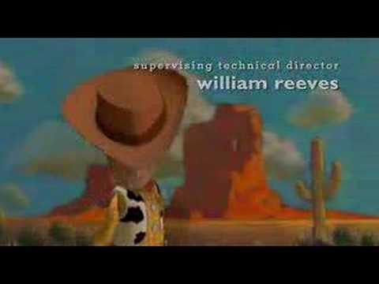
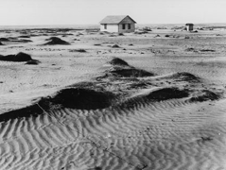
Of Mice and Men
Culture and Times of the Dust Bowl Era
Notes:
*

Slide 2
Essential Questions
How does society, past and present, treat individuals who are mentally challenged?
Why is brotherhood important among men?
How do characters in novels represent people in our lives and society?
How and why do people seek companionship?
Notes:
*

Slide 3
Anticipation Guide
Poll Everywhere Text #37607
A true friend will tell you the truth no matter what.
True- 395531 or False-395532
2. Being rich is more important than having friends. True- 396361 or False- 396366
3. People should be treated differently because of their mental or physical handicaps.
True- 396863 or False- 396864
4. If you dream it, you can achieve it.
True- 396911 or False- 396912

Slide 4
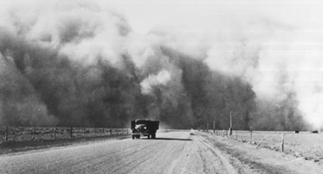
The Dust Bowl
1930’s during Great Depression
A Decade of Dust: http://youtu.be/MYOmjQO_UMw
http://www.history.com/topics/dust-bowl
Caused by human carelessness; overworking the land
Notes:
*

Slide 5
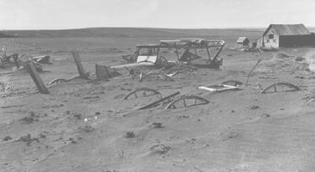
Do you think we could ever have another Dust Bowl or environmental event like it?
Yes 390024
No 390128
Notes:
*

Slide 6
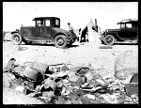
What caused the Migration?
Stock Market crash of 1929
Farmers lost farms
Over-cultivation of lands causing drought
People sought better life in California
Notes:
*

Slide 7
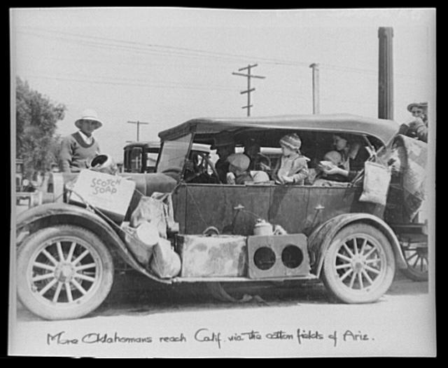
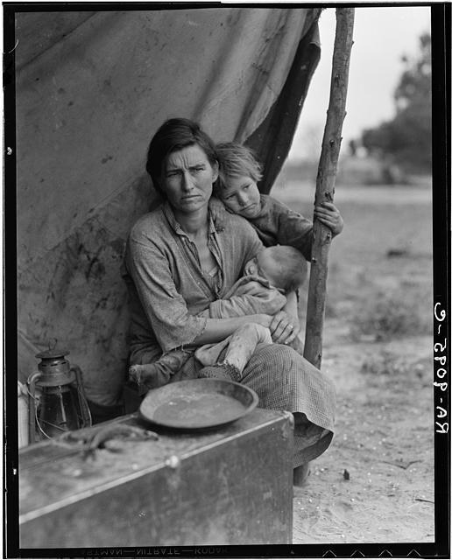
The Age of Migrant Workers
Text 389174 and your message to 37607
Write a tweet for each of the pictures above (remember 140 characters or less and you may use hastags). What is going on in each of these images? What do these pictures say about this time in American history?
Notes:
*

Slide 8
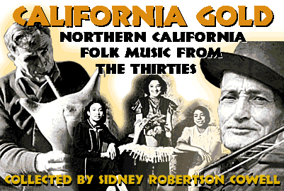
Why California?
Mild climate offered longer farming season
Notes:
*

Slide 9
Mental Disability in 1900’s
By 1915, mental disabilities had caught public attention as perhaps the most significant large-scale social problem of the time.
People had frightened and often hostile attitudes toward the mentally challenged in the early 1900s. Throughout most of this period, health care specialists, equipped with scientific data from hereditary studies, employed measures such as sterilization of the mentally handicapped and segregated them from the larger population by placing them in institutions.
Laws disallowing marriage between mentally disabled people were passed by thirty-nine states.
Coupled with widespread sterilization, the laws were designed to limit the population of the mentally retarded. California, in fact, was one of the pioneers in adopting a eugenic sterilization measure. This scheme, designed to keep the population genetically superior, was eventually accepted by twenty-three states and later by Nazi Germany.
By 1925, 1,374 sterilization operations had been performed on the mentally retarded, 64 percent of which had taken place in California. Of those who escaped such treatment, most were institutionalized.
Notes:
*

Slide 10
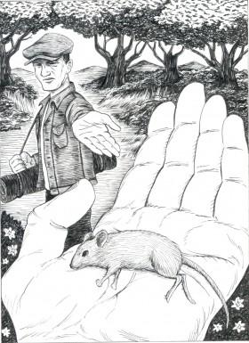
Predictions
What will this novel be about based on the background information and the title of the novel?
Text 182039 and your message to 37607
Notes:
*

Slide 11
Literary Devices/Themes
Symbolism
Character:
Archetypes
Foils
Plot
Irony
Foreshadowing
Setting
Friendship
Paradox of the American Dream
Notes:
*

Slide 12
Important Characters
George Milton- brother figure to Lennie, migrant worker, quick witted, small but intense
Lennie Small- large, childlike migrant worker depends on George to look out for him; doesn’t know his own strength
Candy- aging ranch worker, missing a hand, worries about his future
Curley’s Wife- only female in the story; often referred to as a “tramp”, “tart”, or “looloo”
Slim- advice giver, “prince” of the ranch, respected, highly skilled
Crooks- stable hand, only black character in novel, bitter yet funny, named Crooks for his crooked back.
Curley- The boss’ son, confrontational and mean with Napoleon complex

