Slide 1
Building an SOL Writing Notebook
SOL Writing Notebook
English 11

Slide 2
Front Cover
On the outside cover, label your notebook like this one.
Full Name
SOL Writing
English 11H
Mrs. Clay

Slide 3
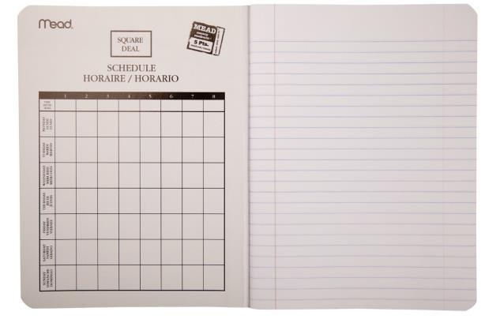
Page 1
Glue or tape the 11th Grade SOL Writing Tests information page to the right-hand page. Number the right side with Page 1. Label as shown.
1

Slide 4
Pages 2 and 3
Glue or tape the Persuasive Essay Outline to the left-hand and right hand pages. Number the left side with 2 and the right side with 3. Label as shown.
Persuasive Essay Outline 2
Persuasive Essay Outline 3

Slide 5
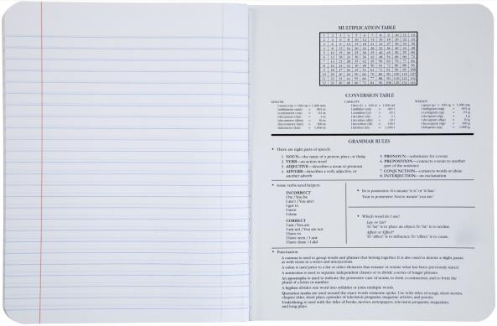
Pages 4 and 5
You will need to tape or glue both pages of the Grade 11 EOC Persuasive Writing Checklist on these pages.
Persuasive Writing Checklist

Slide 6
Pages 6 and 7
You will need to tape or glue the Transitional Words and Phrases page here.
Transitional Words and Phrases

Slide 7
Pages 8 and 9
Leave these 2 pages blank for now.
8
9

Slide 8
Prompt Model Pages
This page will serve as a model for all of your other prompt practice pages. You will glue or tape Prompt #1 in the upper margin of the left-hand page. Label the left and right pages as shown.
Prompt Practice Left Side 10
Right Side Possibilities 11
Restate prompt in your own words:
Thesis:
T-Chart of Opposing Sides:
________________________________________
Follow this format for every prompt.
This side is teacher/student directed
May not be required to complete for every prompt.
Complete an outline for the prompt.
Practice a body paragraphs
Practice writing an introduction (Hook, Bridge, Thesis)
Practice writing a conclusion with counterclaim
Practice incorporating a quotation into your essay.

Slide 9
Prompt Practice Pages
For the 11th Grade EOC (End of Course) Writing Test, there are 47 released practice prompts. Each numbered prompt should be taped or glued into your book. You should place one NUMBERED prompt on the upper margin of the left-hand page. Please keep the prompts in numerical order in your book so you can easily reference them for feedback, help, classwork, or discussion.
SOL Prompt #1

Slide 10
If you do not finish organizing your SOL Writing Prep book in class, please do so by the beginning of class on Wednesday.
We will be working in it every day between now and the SOL test in March.

