Slide 1
SOL Writing Review

Slide 2
Add punctuation to the following sentence:
When I went to the mall I purchased four items a jacket a dress a sweater and a purse.

Slide 3
Choose the correct word from each pair in parentheses:
The (principle/principal) wants to see me in his office, but I don’t want to go (their/there).

Slide 4
Highlight the errors in the following sentence.
Jason’s dog died, he was deeply effected by this.

Slide 5
Add punctuation to the following sentence:
Although the weather forecaster predicted inclement weather the weather was gorgeous.

Slide 6
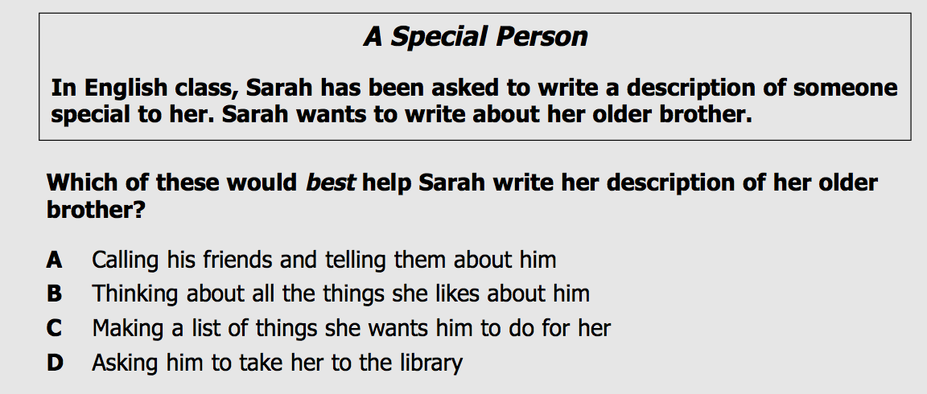
Choose the letter of the best answer.

Slide 7
Choose the letter of the best answer.

Slide 8
What are the three parts of an introduction paragraph (in order)?

Slide 9
Add punctuation to the following sentence:
Let’s eat grandma

Slide 10
Choose the letter of the best answer.

Slide 11
Each body paragraph (with the exception of the last one) should begin with a ___________ for the writer’s position.

Slide 12
Add punctuation to the following sentence:
I have been to many places in the United States New York, New York Honolulu Hawaii and San Diego California.

Slide 13
Which of the following is the best source for an essay on Virginia Beach Public Schools?
The History of the United States
An encyclopedia entry on school systems
A newspaper article on the beginnings of VA Beach schools
A web site on educational initiatives

Slide 14
Choose the letter of the best answer.

Slide 15
On the essay portion of the SOL, what person voice should you use?

Slide 16
Choose the correct word from each pair in parentheses:
(Between/among) you and me, I don’t care for (their/there) food.

Slide 17
Name three conjunctive adverbs.

Slide 18
Highlight the errors in the following sentence.
The peoples’ efforts have paid off, because the constituent recieved less votes this year.

Slide 19
What are two reasons that you would give for the con position?

Slide 20
Which of the following can be used as supporting evidence?
Something you read.
Something you observed.
Something you studied.
Something you experienced.
All of the above

Slide 21
Highlight the errors in the following sentence.
If you don't breath; then you are dead.

Slide 22
How many lines are you allotted on the essay portion of the SOL?

Slide 23
Which of the following should you do on the SOL?
Present two points and a counterpoint
Use contractions like can’t, shouldn’t, and wouldn’t.
Use slang.
Say, “I think.”

Slide 24
Highlight the errors in the following sentence.
I just called to say; “I love you”.

Slide 25
Add punctuation to the following sentence:
Because my son is addicted to Madden 16 he is grounded.

Slide 26
Choose the correct word from each pair in parentheses:
(Lay/lie) the mouse down because (its/it’s) battery is dying.

Slide 27
What are two reasons that you would give for the pro position?

Slide 28
Name all of the FANBOYS in order.

Slide 29
Add punctuation to the following sentence:
I needed to finish my homework however my little brother was bothering me.

Slide 30
Which of the following sentences uses a tone appropriate for the SOL?
Who wants to do homework, lol?
Homework shouldn’t be forced down the throats of poor children like me.
Homework should not be required.
Like homework blows, man.

Slide 31
Add punctuation to the following sentence:
If I really wanted your opinion I would have asked you for it but since I didn’t ask be quiet.

Slide 32
What are counterarguments? Where do they appear in your essay?

Slide 33
Name three subordinating conjunctions.

Slide 34
What punctuation mark do you use before a conjunctive adverb?

Slide 35
Add punctuation to the following sentence:
The night before the test you should get a good night’s sleep.

